Slide 1

Group Three, The Gruntled
Christopher Dreiser, Brett Dube, Daniel Scamardella, Rachel Snyder, Brandon Walters

Slide 2
Project Overview
Program allows organizations to join and post volunteer opportunities
Users can create and edit profiles
Individual volunteer users can then search for and sign up to participate in these opportunities

Slide 3
Effort Over the Semester
Brandon- Testing and Quality Control Lead
Primary programmer of the User class; assisted with the Volunteer and Organization classes
Brett- Design Lead
Primary programmer of the Administrator class; assisted with the User, Volunteer and Organization classes
Christopher- Team Manager and Backend Lead
Lead the effort to implement the backend of the project
Daniel- Lead Programmer
Implemented the Volunteer Opportunity Listing function and lead the overall programming effort
Rachel- GUI Lead and User Manual Author
Created the AccountCreation, EditProfile and LogIn screens; assisted with the backend

Slide 4
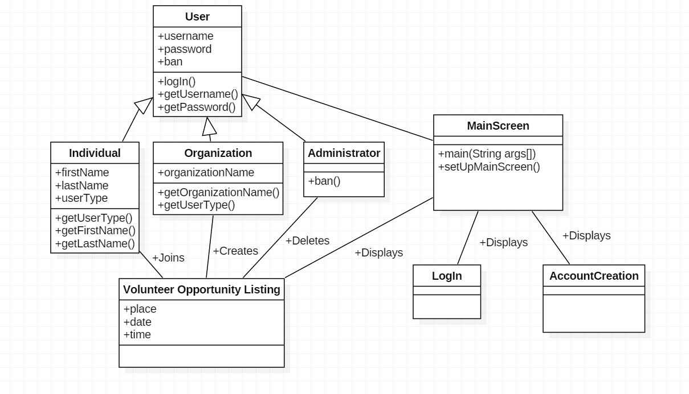
Class Diagram

Slide 5
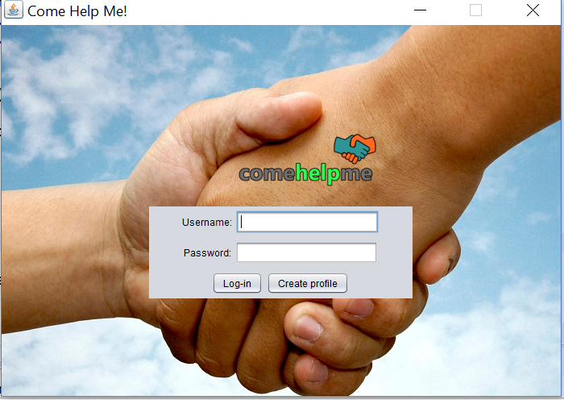
Screen Shots
https://youtu.be/RUdxQ3zafAM

Slide 6
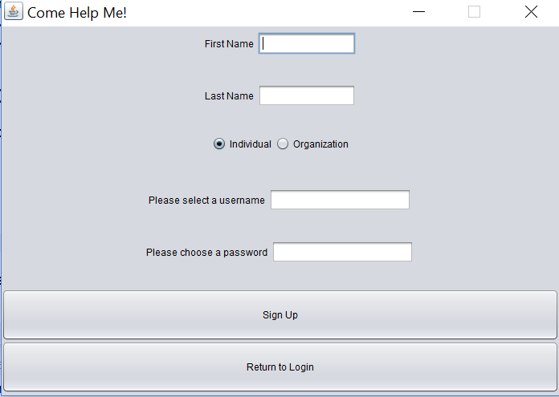
Screen Shots

Slide 7
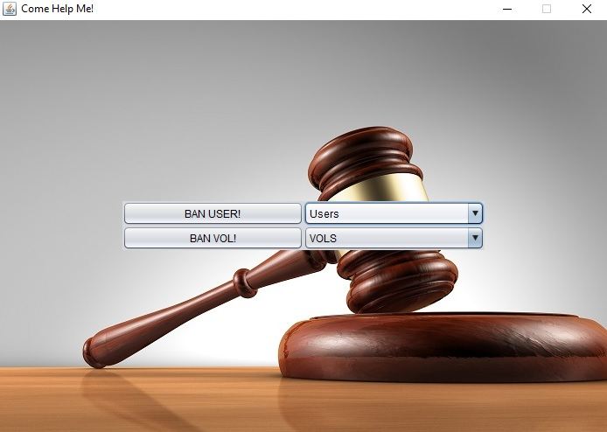
Screen Shots
https://youtu.be/RUdxQ3zafAM

Slide 8
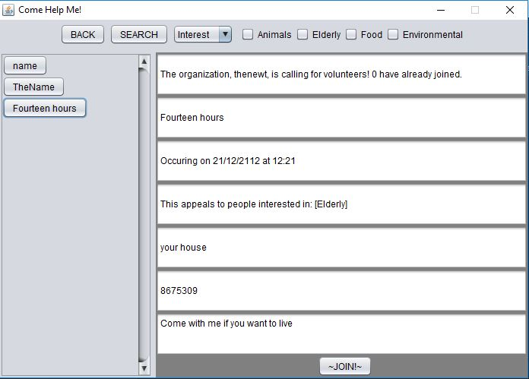
Screen Shots
https://youtu.be/RUdxQ3zafAM

Slide 9
Legacy
Continue to update and improve the visual design
User messaging function
Users would not need to be in contact with one another; easier ways of contacting organizations regards VOLs

Slide 10
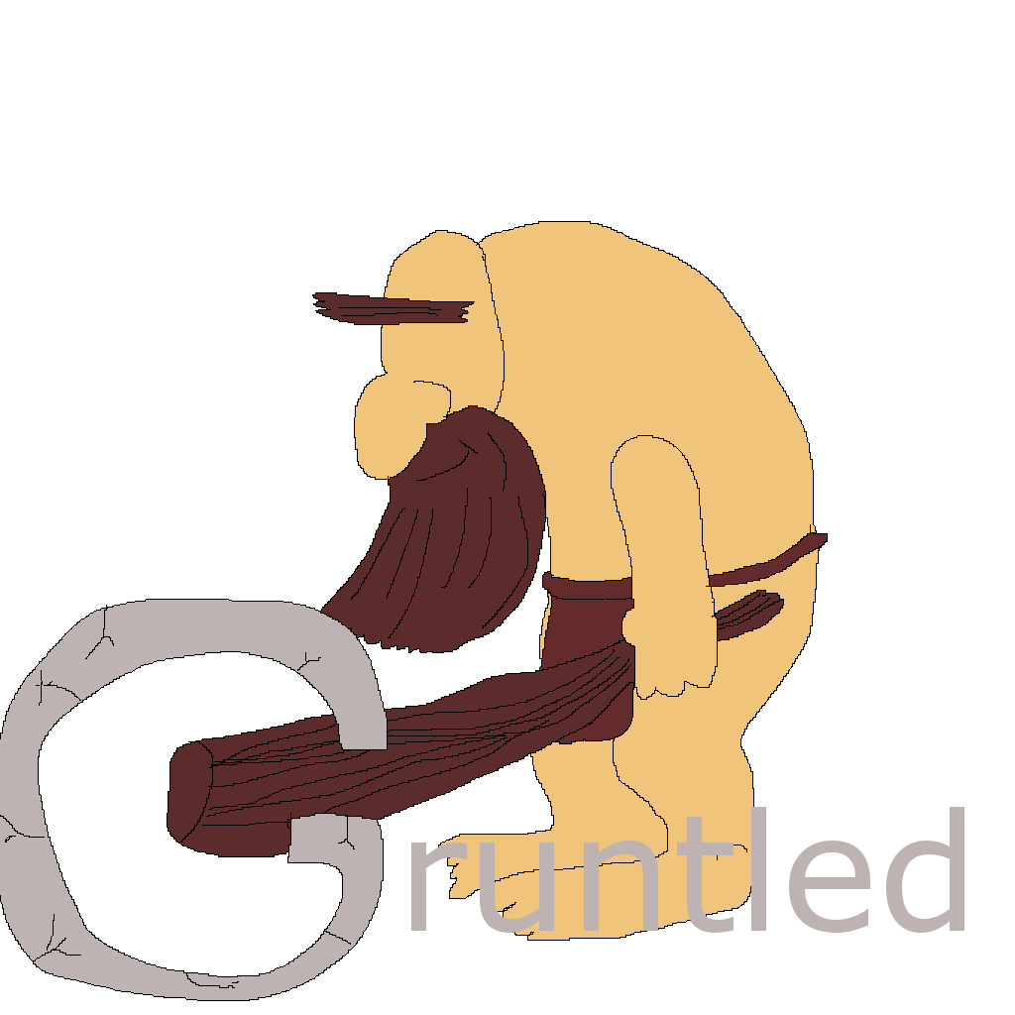
Conclusion
Thank you!
Any questions?

